Slide 1
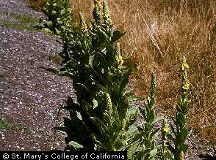
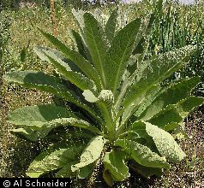
Tree-based Methods for Classification & Regression
Invasive Species in Lava Beds National Monument
Common mullein (Verbascum thapsus) of primary interest.
Other invaders include nettle (Urtica dioica), bull thistle (Cirsium vulgare) and white horehound (Marrubium vulgare).
Notes:
The next few slides describe part of a research project that I worked on with Professors Karen Beard and Tom Edwards from the Quinney College of Natural Resources. Professor Edwards is a federal co-operator with the U.S. Geological Survey Biological Resource Division. Through the federal government, specifically USGS, we obtained a grant to develop methodology to help national parks in the Klamath Network (comprising 6 national parks and national monuments in northern California and southern Oregon) to predict where invasive species may be found in these national parks so that park personnel could eliminate them. In our tour of the park system we saw parks like Redwoods and Oregon Caves where the invasive species problem was very minor through Whisky Town National Recreation area in which it seemed that almost every riparian area was clogged by the invasive Himalayan blackberry impacting native fauna in a very negative way. It was estimated at the time that invasive species cost the U.S. economy over $40 billion a year, and I am sure that figure is even higher now.
In Lava Beds National Monument the primary invader was common mullein but other invasive species present in the park included nettles near the lake, thistles, and white horehound. Mullein can be very hard to eliminate. Seeds can remain viable in a soil bank for 100 years it grows almost anywhere. I have a picture of a mullein plant growing through a tiny crack in the middle of a sealed road.

Slide 2
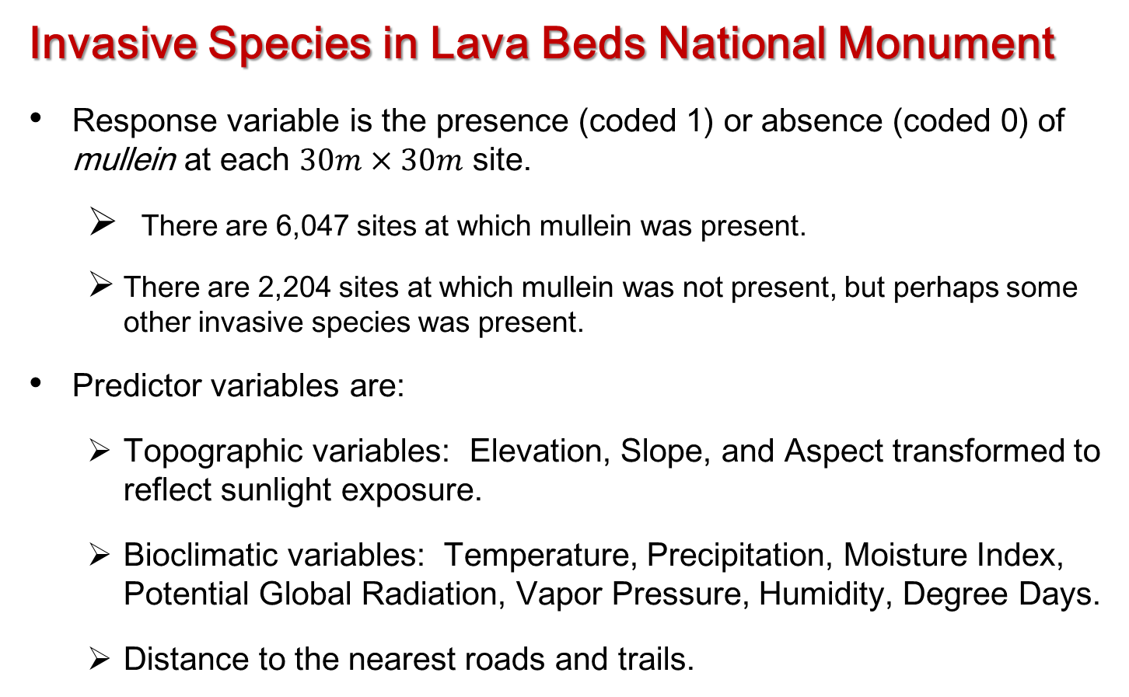
Tree-based Methods for Classification & Regression
Invasive Species in Lava Beds National Monument
Response variable is the presence (coded 1) or absence (coded 0) of mullein at each $30m×30m$ site.
  There are 6,047 sites at which mullein was present.
  There are 2,204 sites at which mullein was not present, but perhaps some other invasive species was present.
Predictor variables are:
  Topographic variables: Elevation, Slope, and Aspect transformed to reflect sunlight exposure.
  Bioclimatic variables: Temperature, Precipitation, Moisture Index, Potential Global Radiation, Vapor Pressure, Humidity, Degree Days.
  Distance to the nearest roads and trails.
Notes:
The park with the best data was Lava Beds and so that’s what we chose for our proof-of–concept analyses. Some of the data consisted of hand drawn “patches” of mullein on a map. We digitized those, dividing Lava Beds into lots of 30m x 30m pixels. From the data given to us by Lava Beds park personnel we found that mullein was present is 6,047 30m x 30m sites and not present in 2,204 sites that park personnel had visited. Those sites were not true absences in that many of them were sites at which other invasive species were present. Further, unlike the lichen data, there was absolutely no random sampling taking place.
The predictor variables include many of our friends from the lichen analyses: topographic variables like elevation, slope, and aspect and bioclimatic predictors including various temperature measures, precipitation, moisture index, humidity, etc.
The new predictors are distances to roads and trails. Professor Beard was the invasive species expert on the project and she told us that the literature was very clear on the point that the vectors by which invasive species came into national parks and any wilds areas were the wheels of cars and boots of hikers. We decided that distance to roads and trails could be the elephants in the room with regard to predictive analyses and we computed them for ever 30m x 30m site in Lava Beds.
My firs training dataset had 8,251 lines, of which mullein was present at 6,047 and absent at the remaining 2,204 sites.

Slide 3
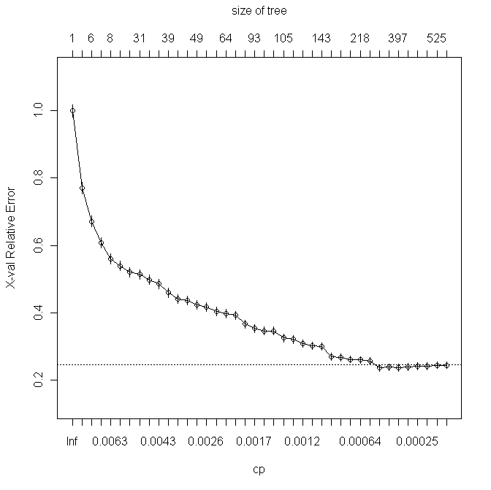
Tree-based Methods for Classification & Regression
Invasive Species in Lava Beds National Monument
Fit fully grown tree. Obtain complexity plot and choose a value of cp.
Notes:
I carried out some preliminary analyses using logistic regression and linear discriminant analysis as a standard for comparison. This was around the time that Random Forests became available in R, so we applied that too. And I fit a tree to the data. You can see from the cost complexity plot that the 1-SE rule chooses a rather large tree with over 300 terminal nodes. Obviously it is not possible to completely interpret such a large tree but this is one time when it is important to follow the 1-SE rule or something like it. If you use the default settings for rpart in R it gives a much smaller tree, which is easy to interpret but has poor predictive accuracy, and predictive accuracy was everything in this problem.

Slide 4
Tree-based Methods for Classification & Regression
Invasive Species in Lava Beds National Monument
Obtain crossvalidated classification accuracies for pruned classification tree, logistic regression, linear discriminant analysis, & Random Forests.
Tree methods look great!!!!
Method | PCC | Specificity | Sensitivity | K | AUC
Pruned tree | 93.50 | 85.98 | 96.25 | 0.8321 | 0.9128
Logistic regression | 80.41 | 47.91 | 92.26 | 0.4454 | 0.8387
Linear discriminant | 79.19 | 49.41 | 90.04 | 0.4261 | 0.8344
Random Forests | 95.20 | 88.84 | 97.52 | 0.8757 | 0.9827
Notes:
The initial results were spectacular! All the methods had high cross-validated predictive accuracies, but trees and Random Forests were particularly excellent. In fact, when my graduate student first showed me the results I said, “Kyle, you must have made a mistake, buddy.” But Professor Adele Cutler and I independently replicated the analyses and got essentially the same results.

Slide 5
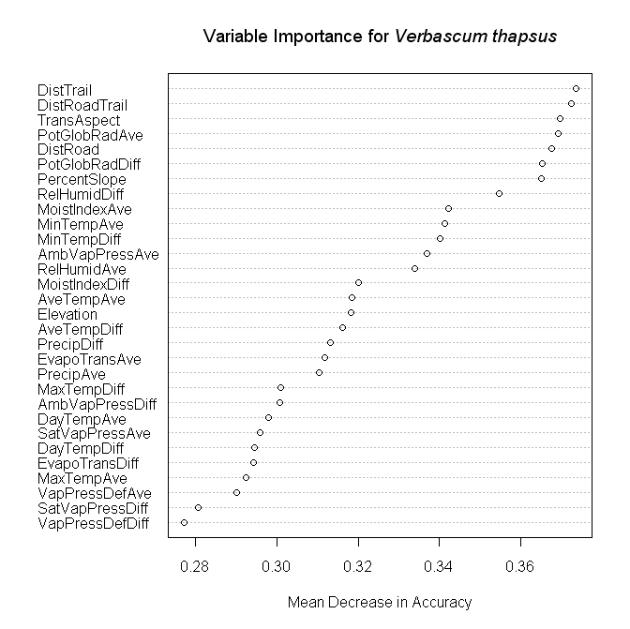
Tree-based Methods for Classification & Regression
Invasive Species in Lava Beds National Monument
Variable Importance plot for Random Forests.
Notes:
As a check, I obtained the variable importances. As expected, the three variables measuring distances to the nearest roads and trails were the two most important and three of the top five. At this point I was feeling very clever and we were ready to pop the champagne corks.
My colleagues and I, however, are strong proponents of checking analyses by prediction onto validation data. Using the remains of our grant we hired an undergraduate researcher and he, with some valuable help from Student Conservation Association (SCA) volunteers collected data from a random sample of approximately 1600 sites throughout Lava Beds National Monument.
When we got and cleaned the data, we waited with baited breath to see how well the predictions from the classifications fit to the training data fit the new, validation data.
The answer was …

Slide 6
Tree-based Methods for Classification & Regression
Invasive Species in Lava Beds National Monument
Obtain classification accuracies on validation data for pruned classification tree, logistic regression, linear discriminant analysis, and Random Forests.
All classification methods look TERRIBLE!!!!!
Method | PCC | Specificity | Sensitivity | K | AUC
Pruned tree | 39.68 | 35.99 | 74.48 | 0.0292 | 0.4765
Logistic regression | 35.85 | 30.65 | 84.43 | 0.0402 | 0.6189
Linear discriminant | 38.10 | 33.14 | 84.83 | 0.0479 | 0.6434
Random Forests | 40.41 | 36.58 | 76.55 | 0.0368 | 0.7141
Notes:
The predictions using all the methods were absolutely dreadful! You know it is bad when you only have two categories and the predictive accuracies are all below 40% and the kappa values are all less than 0.05. That’s at the chance level—you would do as well simply by guessing.
So what went wrong?

Slide 7
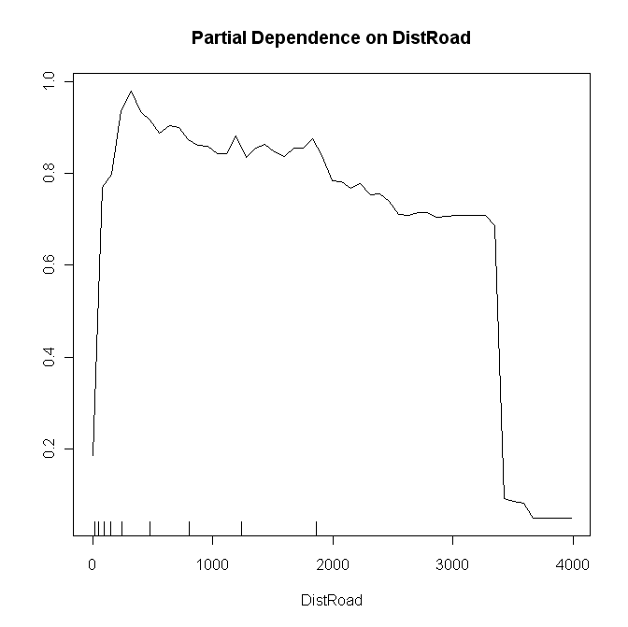
Tree-based Methods for Classification & Regression
Invasive Species in Lava Beds National Monument
Partial dependence plot for DistRoad.
Notes:
The partial dependence plot is key. I should have constructed this when I did the variable importance analyses. In the left side of the plot the logit of the probability of the finding mullein increases with increased distance from roads, which make no sense. Then it just about flattens out up to about 3,500m, and that also doesn’t make sense. The problem is the data we are using for the ‘absences’ of mullein. Really, most of them are sites where other invasive species exist and mullein could exist, and they are not randomly selected in any way. The importance of some kind of random selection cannot be overstated. In another paper we compared predictions made using the lichen air quality data we have used in class with predictions made using some non-randomly selected sites, and the latter predictions are very poor.

Slide 8
Tree-based Methods for Classification & Regression
Invasive Species in Lava Beds National Monument
Solution to the problem:
Strip off all the “absences” for mullein: most of them are presences for other species.
Augment the mullein presences with an equal number (6047) of pseudo-absences randomly selected from a map of Lava Beds National Monument with a 30 m grid overlaid.
Repeat all the analyses on this new dataset.
Notes:
To fix the problem we retain the 6,047 sites where mullein was found and augment those with data from another 6,047 randomly selected sites on the landscape, so called pseudo absences because we assume that mullein is not present at these sites. In a park like Lava Beds where mullein is relatively rare then it is likely that at the vast majority of the randomly selected sites mullein really is not present. And, at least half the data are randomly selected. This may sound a little hokey but pseudoabsences are fairly commonly used in species distribution modeling, and there is quite a bit of literature on how to select pseudoabsences.
The new training dataset has 12,094 data lines and is, therefore, about 50% larger than the original dataset. I reran all the analyses I had on the first training dataset …

Slide 9
Tree-based Methods for Classification & Regression
Invasive Species in Lava Beds National Monument
Obtain crossvalidated classification accuracies for pruned classification tree, logistic regression, linear discriminant analysis, and Random Forests for the augmented data.
All methods look good; tree methods look best.
Method | PCC | Specificity | Sensitivity | K | AUC
Pruned tree | 88.94 | 86.22 | 91.67 | 0.7789 | 0.9221
Logistic regression | 77.78 | 78.87 | 76.70 | 0.5556 | 0.8461
Linear discriminant | 77.67 | 79.38 | 75.96 | 0.5533 | 0.8409
Random Forests | 93.77 | 91.17 | 96.36 | 0.8753 | 0.9824
Notes:
… and obtained these cross-validated accuracy estimates. Classification trees and Random Forests do rather well, better than linear methods.

Slide 10
Tree-based Methods for Classification & Regression
Invasive Species in Lava Beds National Monument
Obtain classification accuracies on validation data for pruned classification tree, logistic regression, linear discriminant analysis, and Random Forests fit on augmented data.
All methods are quite good. Random Forests is best with pruned classification tree second best.
Method | PCC | Specificity | Sensitivity | K | AUC
Pruned tree | 82.14 | 82.37 | 80.00 | 0.3772 | 0.7951
Logistic regression | 74.27 | 73.23 | 84.14 | 0.2788 | 0.8913
Linear discriminant | 75.93 | 74.40 | 90.34 | 0.318 | 0.8970
Random Forests | 87.76 | 89.47 | 71.72 | 0.4644 | 0.8811
Notes:
Predicting onto the validation data we see that Random Forests achieves the highest accuracies followed by a pruned classification tree. One way to view the difference in accuracies between Random Forests and the linear methods is to look at error rates. The error rate for Random Forests at 12.24% is about half of that for the linear methods, and that difference is of practical significance.

Slide 11
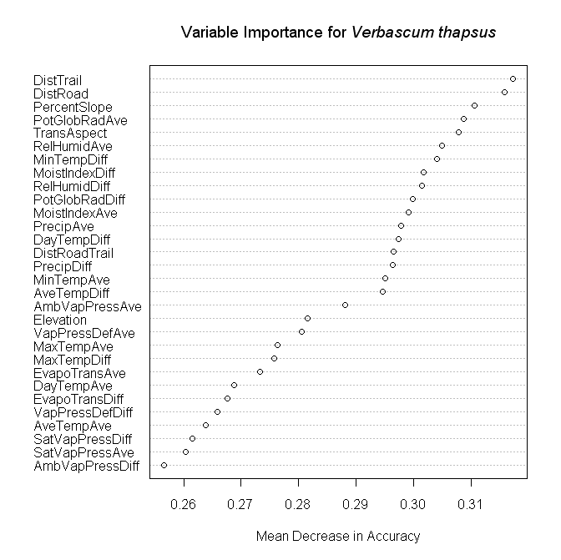
Tree-based Methods for Classification & Regression
Invasive Species in Lava Beds National Monument
Variable Importance plot for Random Forests fit to augmented data.
Notes:
Doing due diligence I obtained variable importances for the mullein analyses. Note that the two most important variables are the distance to the nearest road and distance to the nearest trail, which we would expect.

Slide 12
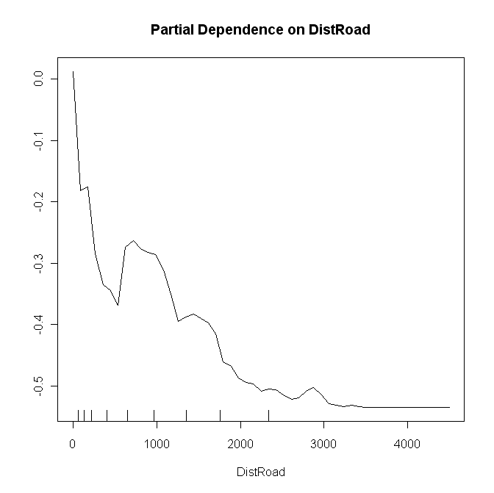
Tree-based Methods for Classification & Regression
Invasive Species in Lava Beds National Monument
Partial dependence plot for DistRoad from augmented data.
Notes:
I then constructed partial dependence plots for DistRoad and DistTrail. Here is the one for DistRoad. This time this plot looks like I would expect. There is a rapid decrease in the (logit of) the probability of mullein being present with distance from the nearest road, and overall there is a strong decreasing trend like the 1/x function. From what we know about how invasive species get into wilderness areas this plot makes perfect sense.
This is an interesting case study. After the second set of analyses achieved our objectives and scope of work for the grant. We had developed predictions of where to look for invasive species, particularly mullein, in Lava Beds National Monument. We believe that the methodology could be applied to other parks, and not just in the Klamath Network.

